Slide 1
CREDITWORTHINESS PREDICTION USING MACHINE LEARNING
USING DATA TO DRIVE SMARTER LENDING DECISIONS
AUTHOR: VICTORIA AND PRUDENCE

Slide 2
Introduction
Objective: Build ML models to predict loan creditworthiness.
Data source: Historical loan application dataset.
Techniques: EDA, Feature Engineering, Resampling, Modeling, Evaluation.
-

Slide 3
Problem Statement
Many financial institutions face high default rates due to unreliable manual credit assessments. There’s a need for a data-driven, consistent approach to assess credit risk.
Banks want to predict if a loan applicant will repay (creditworthy).
Wrong decisions lead to financial loss or unfair loan rejection.

Slide 4
Project Objective
This project aims to develop a machine learning model that can accurately predict an individual’s creditworthiness. Analyzing factors such as income, credit history, education, and dependents, we build predictive models that help financial institutions make informed lending decisions.
Goal: Use historical data to predict loan approval accurately.

Slide 5
Dataset Overview
Total records: 5898 customer profiles.
Features: Gender, Married, Dependents, Education, Self Employed, Applicant Income, Coapplicant Income, Loan Amount, Loan Amount Term, Credit History, Property Area.
Target: Loan Status.
Class imbalance: 83% approved, 17% rejected.

Slide 6
Methodology Data Cleaning & Preprocessing
Checked for and handled missing values and duplicates to ensure data integrity.
‘Dependents' column: Values like '3+' were converted to numeric 3 to treat dependents quantitatively. Justification: Ensures consistency in numeric analysis and modeling, preventing errors during training.
Dropped 'Loan_ID' and 'ID' columns as unique identifiers carry no predictive power.
Recalculated the ‘Total_Income’ as there was error found in the calculation.
Applied one hot encoding to categorical variable: ‘Dependents’ and ‘Property_Area’.

Slide 7
Exploratory Data Analysis (EDA)
Married, Males, Salaried applicants, Non-graduates, those who resides in semi-urban areas and have no dependents tend to get approved more.
Income alone does not differentiate approvals well.
Credit history is the strongest predictor of loan approval.

Slide 8
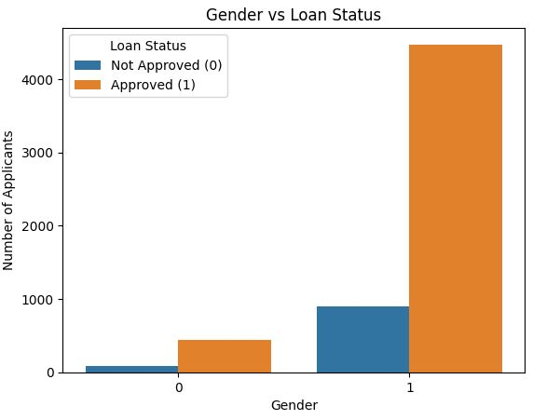
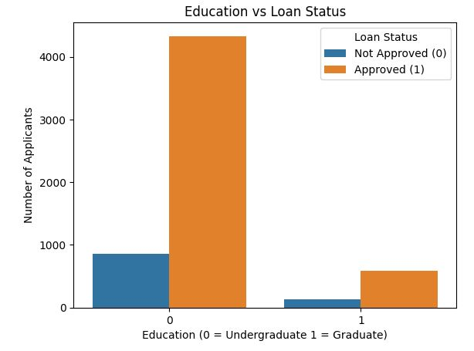
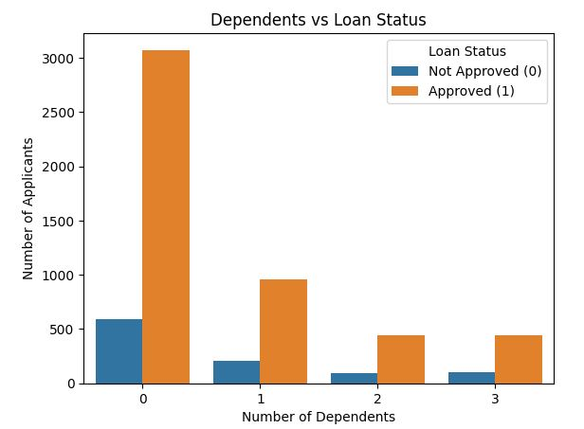
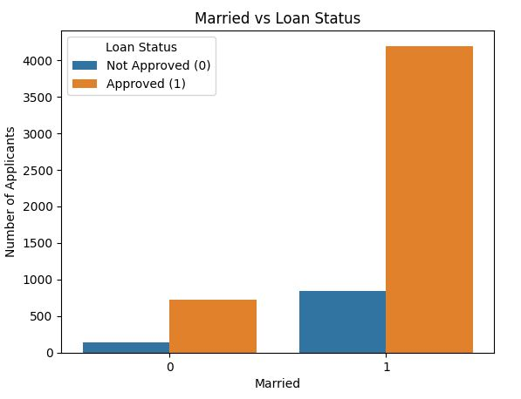
Categorical Variables

Slide 9
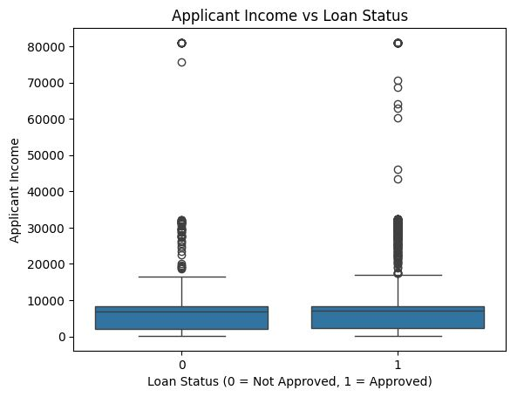
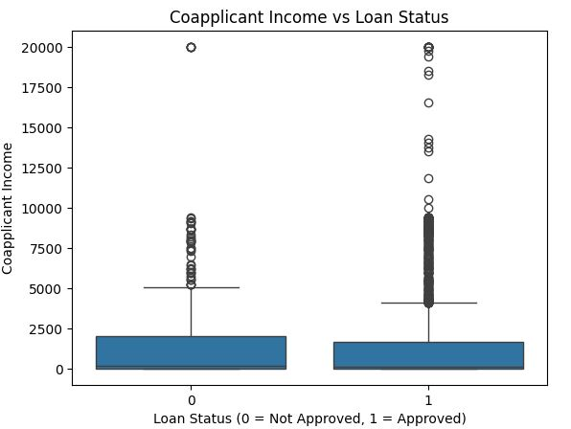
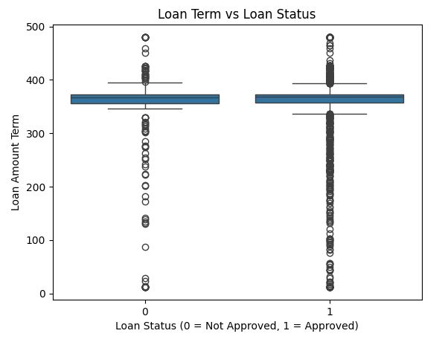
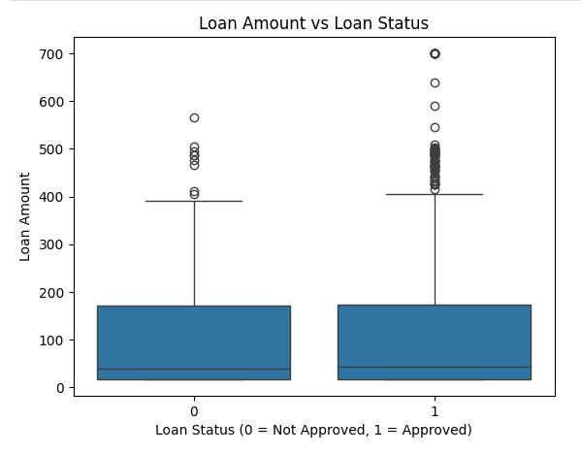
Numerical Variables

Slide 10
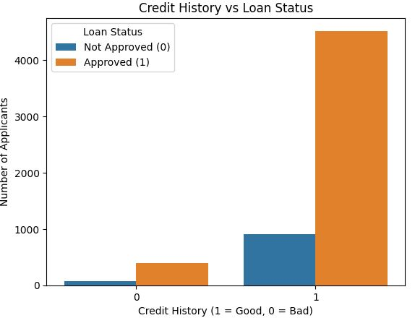
Credit History vs Loan Status

Slide 11
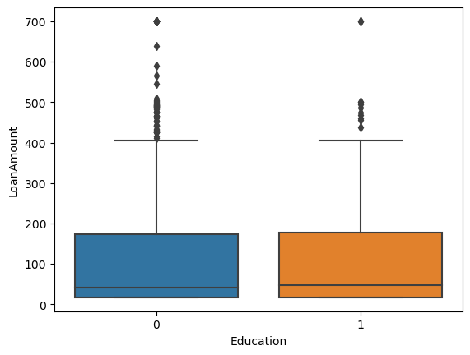
Loan Amount Distribution by Education
Boxplot compares 'Loan Amount' distributions for graduates vs. non-graduates.
Interpretation: Education level does not significantly affect loan amounts; both groups show similar medians and IQRs.

Slide 12
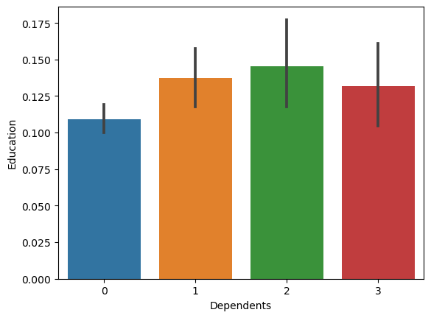
Proportion of Graduates by Dependents
Bar plot shows the mean of 'Education' (proportion of graduates) across different 'Dependents' values.
Interpretation: Individuals with more dependents (up to 2) are slightly more likely to be graduates.

Slide 13
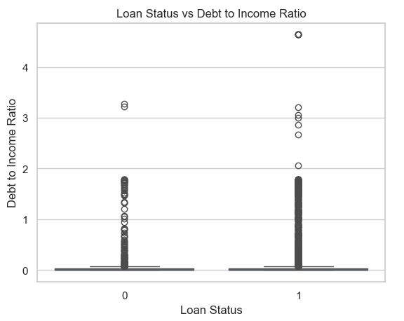
Debt to Income Ratio
Boxplot compares ‘Debt to Income Ratio' distributions for approved vs. non-approved.
On average, both approved and rejected applicants had roughly the same level of debt compared to their income. So, DTI alone may not have been a major deciding factor for most loan decisions.

Slide 14
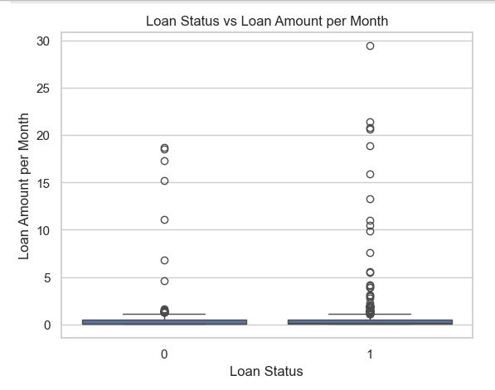
Loan Amount Per Month
Boxplot compares ‘Loan Amount per Month' distributions for approved vs. non-approved.
Interpretation: Loan Amount per Month does not significantly affect loan approval.

Slide 15
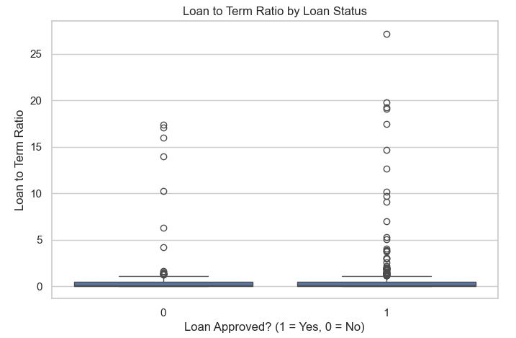
Loan To Term Ratio
Boxplot compares ‘Loan to Term Ratio' distributions for approved vs. non-approved.
Interpretation: Loan to Term Ratio does not significantly affect loan approval.

Slide 16
Models Used
Logistic Regression: interpretable, baseline classifier.
Decision Tree Classifier: interpretable rule-based model.
Random Forest Classifier: ensemble of trees for robustness.
XGBoost
Random Forest and XGBoost handle complex relationships well.
Perform robustly on imbalanced data.
Provide feature importance insights for explainability.
Balance accuracy and interpretability

Slide 17
Initial Performance (Before Resampling)
Model | Accuracy | Recall |  | Precision |  | F1 |  | ROU AUC
 |  | Class 0 | Class 1 | Class 0 | Class 1 | Class 0 | Class 1
Logistic Regression | 0.52 | 0.44 | 0.54 | 0.16 | 0.83 | 0.23 | 0.65 | 0.49
Decision Tree | 0.71 | 0.14 | 0.83 | 0.14 | 0.83 | 0.14 | 0.83 | 0.48
Random Forest | 0.83 | 0.01 | 0.99 | 0.17 | 0.83 | 0.02 | 0.90 | 0.42
XGBoost | 0.65 | 0.16 | 0.75 | 0.11 | 0.82 | 0.13 | 0.78 | 0.41

Slide 18
Performance (After Resampling)
Model | Accuracy | Recall |  | Precision |  | F1 |  | ROU AUC
 |  | Class 0 | Class 1 | Class 0 | Class 1 | Class 0 | Class 1
Logistic Regression | 0.49 | 0.45 | 0.50 | 0.15 | 0.82 | 0.23 | 0.62 | 0.47
Decision Tree | 0.69 | 0.11 | 0.80 | 0.10 | 0.82 | 0.10 | 0.81 | 0.46
Random Forest | 0.71 | 0.16 | 0.82 | 0.16 | 0.83 | 0.16 | 0.83 | 0.49
XGBoost | 0.75 | 0.10 | 0.88 | 0.15 | 0.83 | 0.12 | 0.86 | 0.49

Slide 19
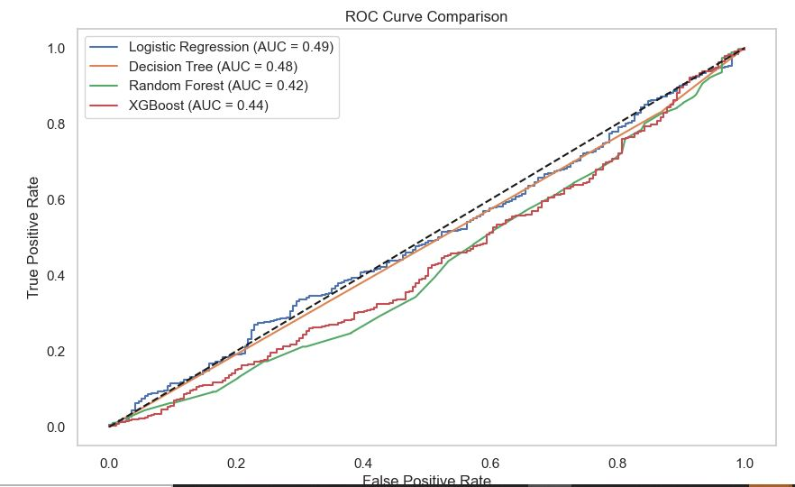
ROC Curve

Slide 20
Best Model
Given the project's priority of minimizing risky loans by detecting non-creditworthy applicants (class 0), Logistic Regression with SMOTE and class_weight='balanced' is the best-performing model.
It delivers the highest recall (0.45) and highest F1 score (0.23) for the minority class, making it the most effective at catching risky borrowers — which aligns with our core business objective.
Supporting Model: Random Forest. While it is not great on recall (0.16), it has the highest precision on Class 0 (0.16), decent F1 (0.16) and the highest ROU AUC (0.49).

Slide 21
ROC Curve Comparison
Random Forest and XGBoost saw clear improvements in ROU AUC after applying SMOTE, indicating that handling class imbalance helped these models better distinguish between approved and unapproved applicants.
Logistic Regression and Decision Tree experienced a slight decrease in AUC, possibly due to sensitivity to oversampling or model simplicity.
Post-SMOTE, XGBoost and Random Forest both achieved AUC of 0.49, making them the top-performing models for creditworthiness prediction based on this metric.

Slide 22
Most Important Features
Credit History - strongest influence on approval.
Debt-to-Income Ratio - higher ratios indicate higher risk.
Loan Amount and Term affect repayment burden.
Employment Status influences income stability.
Marital Status and Property Area also have impact.

Slide 23
Business Implications
Use model to improve loan approval decisions and reduce defaults.
Since credit history strongly influences loan approvals, banks should prioritize applicants with positive credit histories or help those with poor history improve their credit scores before reapplying.
Focus on debt ratios in order to minimize risk.
Reduce unfair rejections based on irrelevant features like income alone.
Encourage applicants to apply for loan amounts proportional to their income and suggest optimal loan terms that keep monthly payments manageable to reduce default risk.
Design loan products targeting different income groups or employment types (self-employed vs salaried) to serve customer needs better and minimize defaults.

Slide 24
Next Steps
Extreme outliers (very high incomes or loan requests) should be investigated individually to understand if they represent risk or special cases. Handling outliers and class imbalance is crucial for model accuracy.
Since males, undergraduates, and those in semi-urban areas have higher approval rates, further study can explore if any bias exists or if these groups genuinely have better repayment records.
Deploy the model in loan approval process.
Continuously monitor and update with new data.
Leverage insights to create better financial products.
Final model can aid financial institutions in fair loan decisions.

Slide 25
Thank You / Questions
Thank you
Feel free to ask any questions.

